Slide 1
CS 388: Natural Language Processing: LSTM Recurrent Neural Networks
Raymond J. Mooney
University of Texas at Austin
Borrows significantly from:
http://colah.github.io/posts/2015-08-Understanding-LSTMs/

Slide 2
Vanishing/Exploding Gradient Problem
Backpropagated errors multiply at each layer, resulting in exponential decay (if derivative is small) or growth (if derivative is large).
Makes it very difficult train deep networks, or simple recurrent networks over many time steps.

Slide 3
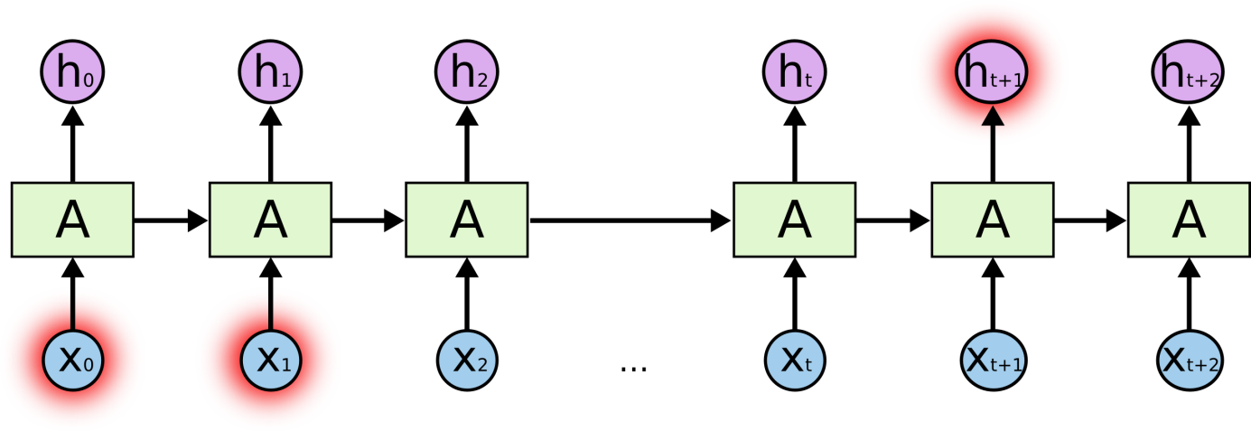
Long Distance Dependencies
It is very difficult to train SRNs to retain information over many time steps
This make is very difficult to learn SRNs that handle long-distance dependencies, such as subject-verb agreement.

Slide 4
Long Short Term Memory
LSTM networks, add additional gating units in each memory cell.
Forget gate
Input gate
Output gate
Prevents vanishing/exploding gradient problem and allows network to retain state information over longer periods of time.

Slide 5

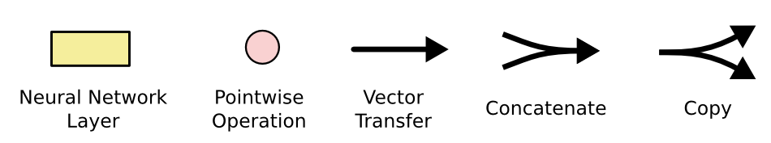
LSTM Network Architecture

Slide 6
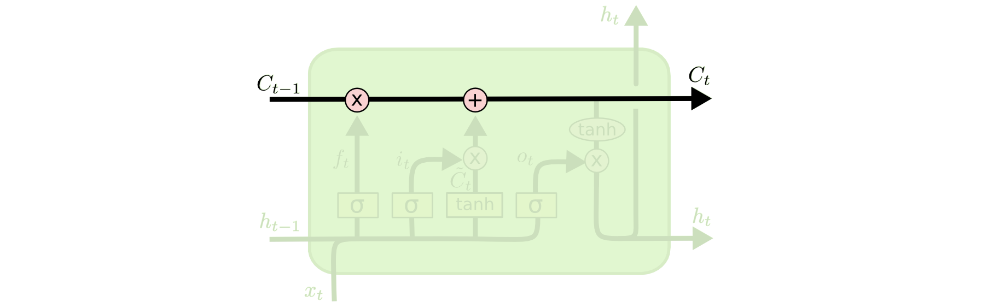
Cell State
Maintains a vector C_{t} that is the same dimensionality as the hidden state, h_{t}
Information can be added or deleted from this state vector via the forget and input gates.

Slide 7
Cell State Example
Want to remember person & number of a subject noun so that it can be checked to agree with the person & number of verb when it is eventually encountered.
Forget gate will remove existing information of a prior subject when a new one is encountered.
Input gate "adds" in the information for the new subject.

Slide 8
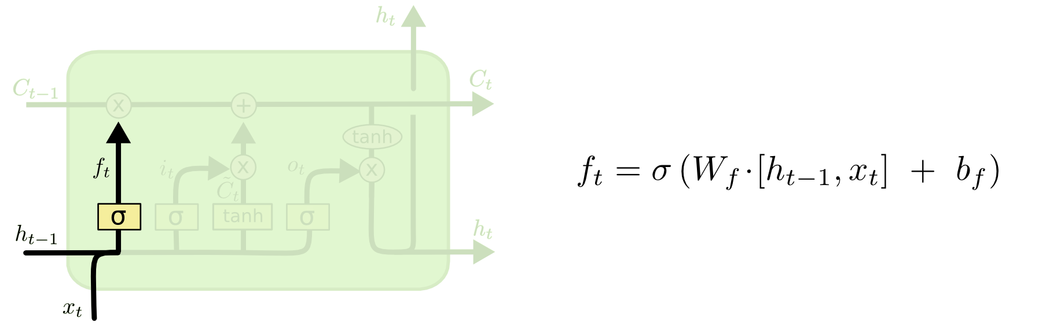
Forget Gate
Forget gate computes a 0-1 value using a logistic sigmoid output function from the input, x_{t}, and the current hidden state, h_{t}:
Multiplicatively combined with cell state, "forgetting" information where the gate outputs something close to 0.

Slide 9
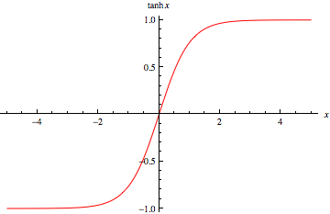
Hyperbolic Tangent Units
Tanh can be used as an alternative nonlinear function to the sigmoid logistic (0-1) output function.
Used to produce thresholded output between –1 and 1.

Slide 10
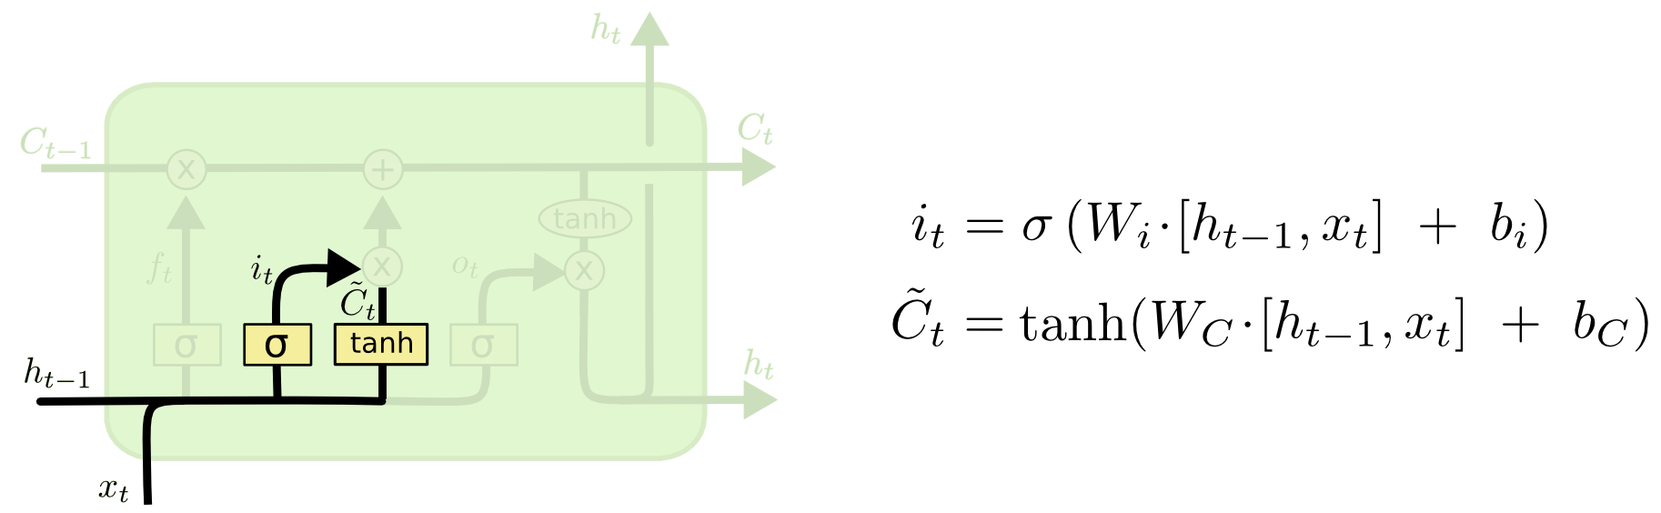
Input Gate
First, determine which entries in the cell state to update by computing 0-1 sigmoid output.
Then determine what amount to add/subtract from these entries by computing a tanh output (valued –1 to 1) function of the input and hidden state.

Slide 11
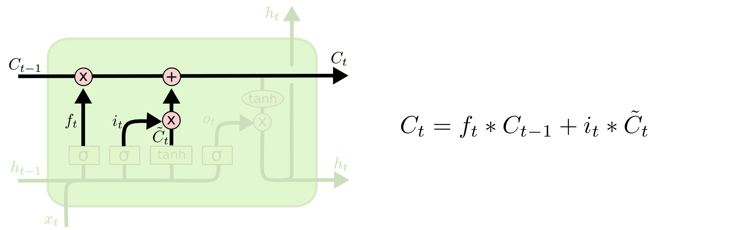
Updating the Cell State
Cell state is updated by using component-wise vector multiply to "forget" and vector addition to "input" new information.

Slide 12
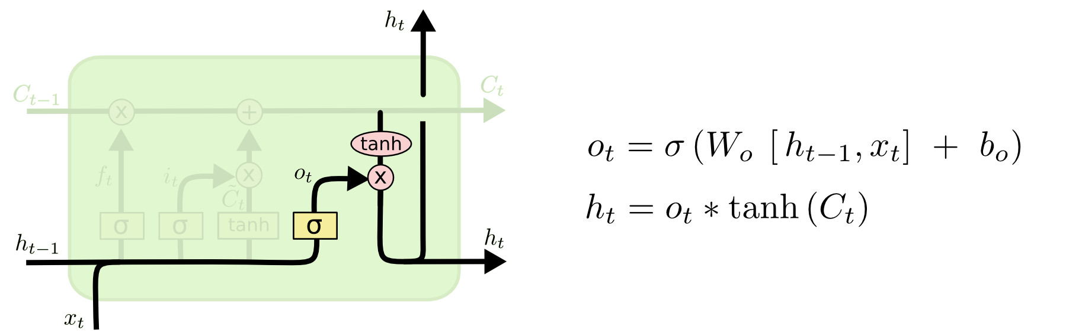
Output Gate
Hidden state is updated based on a "filtered" version of the cell state, scaled to –1 to 1 using tanh.
Output gate computes a sigmoid function of the input and current hidden state to determine which elements of the cell state to "output".

Slide 13

Overall Network Architecture
Single or multilayer networks can compute LSTM inputs from problem inputs and problem outputs from LSTM outputs.
O_{t}
e.g. a POS tag as a “one hot” vector
e.g. a word “embedding” with
reduced dimensionality
I_{t}
e.g. a word as a “one hot” vector

Slide 14
LSTM Training
Trainable with backprop derivatives such as:
Stochastic gradient descent (randomize order of examples in each epoch) with momentum (bias weight changes to continue in same direction as last update).
ADAM optimizer (Kingma & Ma, 2015)
Each cell has many parameters (W_{f}, W_{i}, W_{C}, W_{o})
Generally requires lots of training data.
Requires lots of compute time that exploits GPU clusters.

Slide 15
General Problems Solved with LSTMs
Sequence labeling
Train with supervised output at each time step computed using a single or multilayer network that maps the hidden state (h_{t}) to an output vector (O_{t}).
Language modeling
Train to predict next input (O_{t} =I_{t+1})
Sequence (e.g. text) classification
Train a single or multilayer network that maps the final hidden state (h_{n}) to an output vector (O).

Slide 16
Sequence to Sequence Transduction (Mapping)
Encoder/Decoder framework maps one sequence to a "deep vector" then another LSTM maps this vector to an output sequence.
Encoder
LSTM
Decoder
LSTM
I₁, I₂,…,I_{n}
h_{n}
O₁, O₂,…,O_{m}
Train model "end to end" on I/O pairs of sequences.

Slide 17
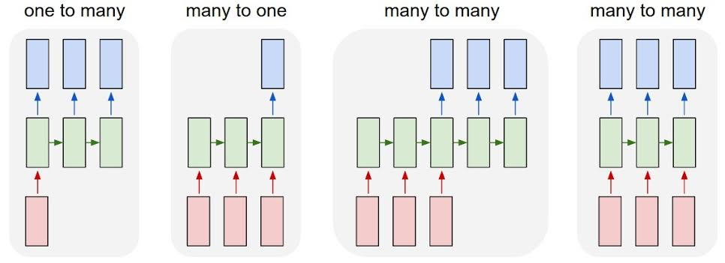
Summary of LSTM Application Architectures
Image Captioning
Video Activity Recog
Text Classification
Video Captioning
Machine Translation
POS Tagging
Language Modeling

Slide 18
Successful Applications of LSTMs
Speech recognition: Language and acoustic modeling
Sequence labeling
POS Tagging https://www.aclweb.org/aclwiki/index.php?title=POS_Tagging_(State_of_the_art)
NER
Phrase Chunking
Neural syntactic and semantic parsing
Image captioning: CNN output vector to sequence
Sequence to Sequence
Machine Translation (Sustkever, Vinyals, & Le, 2014)
Video Captioning (input sequence of CNN frame outputs)

Slide 19


Bi-directional LSTM (Bi-LSTM)
Separate LSTMs process sequence forward and backward and hidden layers at each time step are concatenated to form the cell output.
x_{t-1}
x_{t}
x_{t+1}
h_{t-1}
h_{t}
h_{t+1}

Slide 20
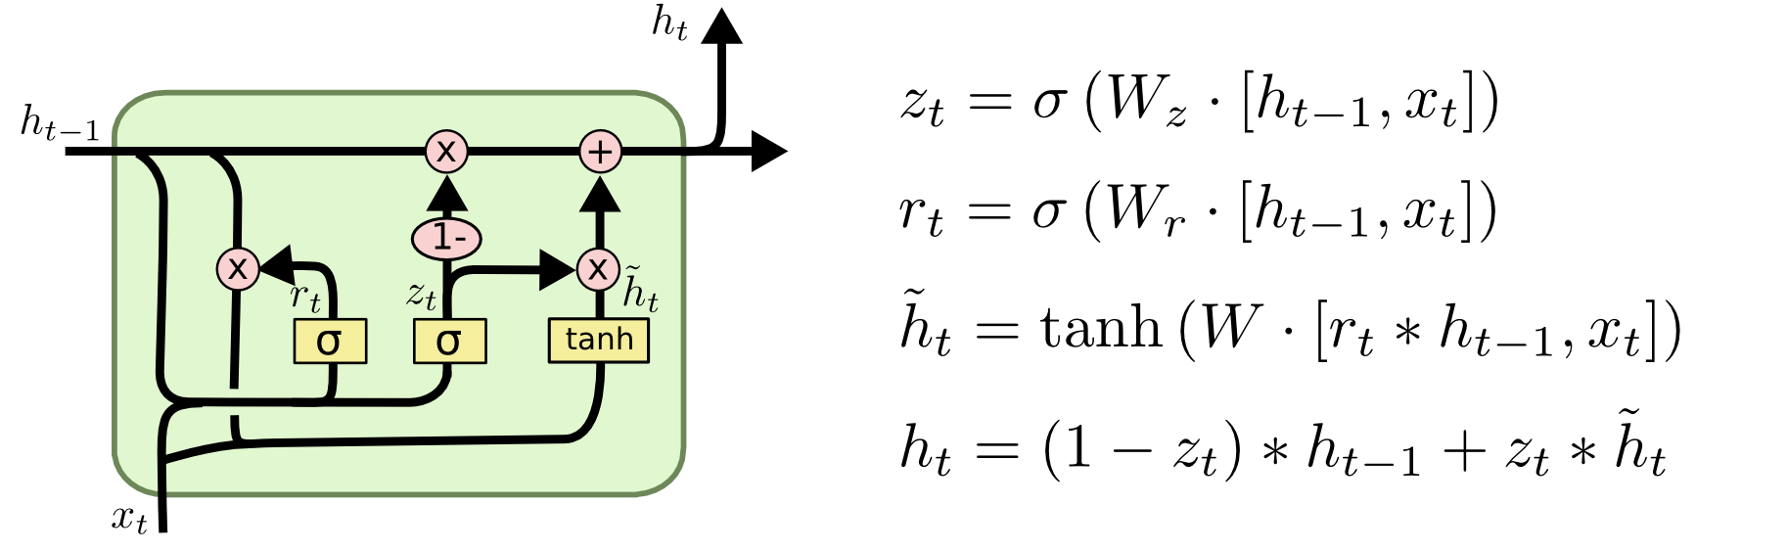
Gated Recurrent Unit (GRU)
Alternative RNN to LSTM that uses fewer gates (Cho, et al., 2014)
Combines forget and input gates into “update” gate.
Eliminates cell state vector

Slide 21
GRU vs. LSTM
GRU has significantly fewer parameters and trains faster.
Experimental results comparing the two are still inconclusive, many problems they perform the same, but each has problems on which they work better.

Slide 22
Attention
For many applications, it helps to add “attention” to RNNs.
Allows network to learn to attend to different parts of the input at different time steps, shifting its attention to focus on different aspects during its processing.
Used in image captioning to focus on different parts of an image when generating different parts of the output sentence.
In MT, allows focusing attention on different parts of the source sentence when generating different parts of the translation.

Slide 23
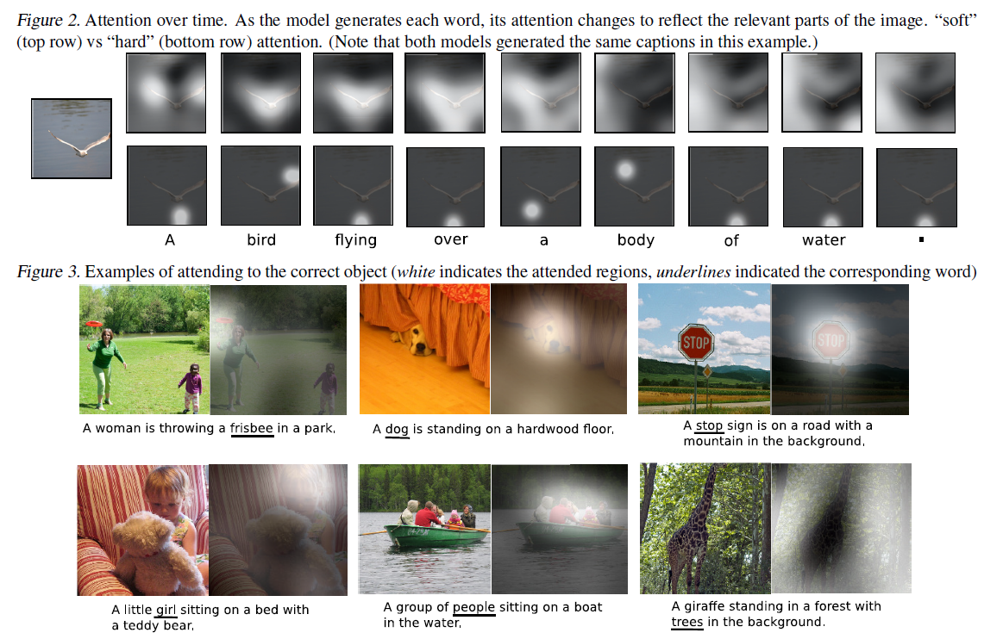
Attention for Image Captioning (Xu, et al. 2015)

Slide 24
Conclusions
By adding “gates” to an RNN, we can prevent the vanishing/exploding gradient problem.
Trained LSTMs/GRUs can retain state information longer and handle long-distance dependencies.
Recent impressive results on a range of challenging NLP problems.

